Slide 1
Unit 3. Deadlock

Slide 2
Deadlock
A Deadlock is a situation where each of the computer process waits for a resource which is being assigned to some another process.
In this situation, none of the process gets executed since the resource it needs, is held by some other process which is also waiting for some other resource to be released.
Let us assume that there are three processes P1, P2 and P3.
There are three different resources R1, R2 and R3.
R1 is assigned to P1, R2 is assigned to P2 and R3 is assigned to P3.
After some time, P1 demands for R1 which is being used by P2. P1 halts its execution since it can't complete without R2.
P2 also demands for R3 which is being used by P3. P2 also stops its execution because it can't continue without R3.
P3 also demands for R1 which is being used by P1 therefore P3 also stops its execution.

Slide 3
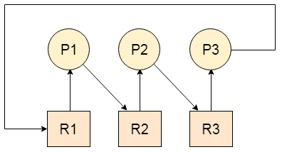
In this scenario, a cycle is being formed among the three processes. None of the process is progressing and they are all waiting.
The computer becomes unresponsive since all the processes got blocked.

Slide 4
Resource Type: Preemptable and Non-preemptable Resources:
Preemptable Resources: These are resources that can be taken away from a process without causing failure. For example, CPU time may be preemptable.
Non-preemptable Resources: Resources that cannot be taken away from a process until it willingly releases them. For instance, a printer may be a non-preemptable resource.

Slide 5
Conditions For Deadlock
There are following 4 necessary conditions for the occurrence of deadlock-
Mutual Exclusion: A resource can only be shared in mutually exclusive manner. It implies, two process cannot use the same resource at the same time.
Hold and Wait: A process waits for some resources while holding another resource at the same time.
No preemption: The process which once scheduled will be executed till the completion. No other process can be scheduled by the scheduler meanwhile.
Circular wait: All the processes must be waiting for the resources in a cyclic manner so that the last process is waiting for the resource which is being held by the first process.
All these 4 conditions must hold simultaneously for the occurrence of deadlock.
If any of these conditions fail, then the system can be ensured deadlock free.

Slide 6
Methods for Handling Deadlocks
There are three ways of handling deadlocks:
• Deadlock prevention
• Deadlock avoidance
• Deadlock detection and recovery

Slide 7
Deadlock prevention
Different protocols are used to prevent or avoid deadlocks, ensuring that the system will never enter a deadlocked state.
To prevent the system from deadlocks, one of the four conditions that may create a deadlock should be discarded.
The methods for those conditions are as follows:
Mutual Exclusion:
Hold and Wait:
No Preemption:
Circular Wait:

Slide 8
Deadlock avoidance
Deadlock can be avoided if certain information about processes is available to the operating system before allocation of resources, such as which resources a process will consume in its lifetime.
For every resource request, the system sees whether granting the request will mean that the system will enter an unsafe state, meaning a state that could result in deadlock.
The system then only grants requests that will lead to safe states.
Deadlock avoidance algorithm can be classified into following two methods:
a) Safe state
Safe State: A system state where deadlock is not possible.
Unsafe State: A system state where deadlock might occur.
b) Resource allocation graph

Slide 9
Safe state
A state is safe if the system can allocate resources to each process in some order and still avoid a deadlock.
Let us consider a system with 12 magnetic tape drives and 3 processes P0, P1, and P2.
The process P0 requires 10 tape drives; P1 may need 4 tape drives and process P2 needs up to 9 tape drives.
Suppose at time T0, process P0 is holding 5 tape drives, process P1 is holding 2 tape drives and process P2 is holding 2 tape drives.
It is shown in following table

Slide 10
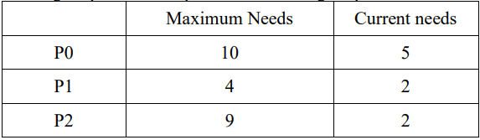
At the time T0, the system is in safe state.
The sequence < P1, P0, P2> satisfies the safety condition. Process P1 can immediately be allocated all its tape drives and then return them (the system will have 5 available tape drives), then process P0 can get all its tape drives and return them (the system will have 10 available tape drives) and finally process P2 can get all tape drives and return them (the system will then have all 12 tape drives available).
A system can go from a safe state to unsafe state.
Suppose that, at time T1, process P2 requests and is allocated one more tape drive. The system is no longer in safe state. At this state only process P1 can be allocated all its tape drives. When it returns them, the system will have only four available tape drives. Since process P0 is allocated 5 tape drives but has a maximum of 10, it may request 5 more tape drives. If it does so, it will have to wait, because they are unavailable. Similarly, process P2 may request 6 additional tape drives and have to wait, resulting in deadlock.
The mistake was in granting the request from process P2 for 1 more tape drive. If the process P2 wait until either of the other processes had finished and released its resources, then we could have avoided the deadlock.

Slide 11
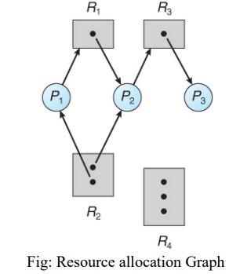
Resource Allocation Graph
Deadlock can also be described in terms of a directed graph called resource allocation graph.
This graph consists of a set of vertices V and set of edges E.
The set of vertices V is portioned into two different types of nodes:
The set of all actives process P = {P1, P2, P3, … , Pn} in the system and
The set consisting of all resource types in the system.

Slide 12
Request Edges - A set of directed arcs from Pi to Rj, indicating that process Pi has requested Rj, and is currently waiting for that resource to become available.
Assignment Edges - A set of directed arcs from Rj to Pi indicating that resource Rj has been allocated to process Pi, and that Pi is currently holding resource Rj.
In above diagram, there are: The sets P, R, and E:
P = {P1, P2, P3}
R = {R1, R2, R3, R4}
E = { P1 → R1, P2 → R3, R1 → P2, R3 → P3, R2 → P1, R2 → P2} Resources Instances: One instance of resource R1 and R3
Two instance of resource R2
Three instances of resource R4

Slide 13
Process states:
Process P1 is holding an instance of resources type R2 and is waiting for an instance of resource type R1.
Process P2 is holding an instance of resources type R1 and an instance of R2 is waiting for an instance of resource type R3.
Process P3 is holding an instance of resources type R3
If a resource-allocation graph contains no cycles, then the system is not deadlocked.
If the graph contains a cycle, then a deadlock may exist

Slide 14
Banker's Algorithm:
Banker’s Algorithm is a deadlock avoidance strategy.
It is called so because it is used in banking systems to decide whether a loan can be granted or not.
Banker’s Algorithm requires-
Whenever a new process is created, it specifies the maximum number of instances of each resource type that it exactly needs.

Slide 15
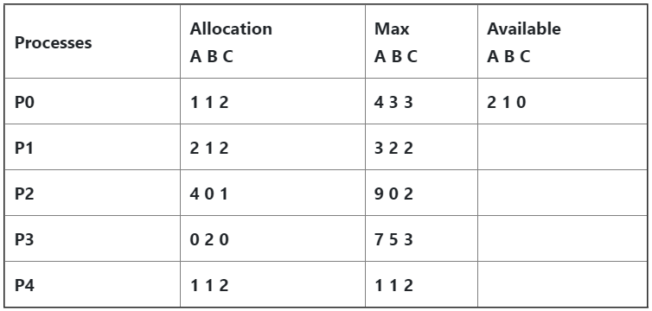
Let us consider the following
Calculate the content of the need matrix?
Check if the system is in a safe state?
Determine the total sum of each type of resource?

Slide 16
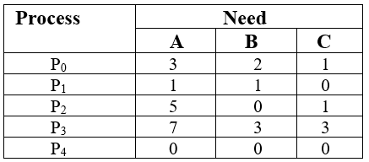
Solution:
1. The Content of the need matrix can be calculated by using the formula given below:
Need = Max – Allocation

Slide 17
2. Let us now check for the safe state.
Safe sequence:
For process P0, Need = (3, 2, 1) and Available = (2, 1, 0)
Need <=Available = False
So, the system will move to the next process.
For Process P1, Need = (1, 1, 0) , Available = (2, 1, 0)
Need <= Available = True
Request of P1 is granted.
Available = Available +Allocation
= (2, 1, 0) + (2, 1, 2)
= (4, 2, 2) (New Available)

Slide 18
For Process P2, Need = (5, 0, 1) Available = (4, 2, 2)
Need <=Available = False
So, the system will move to the next process.
For Process P3, Need = (7, 3, 3) Available = (4, 2, 2)
Need <=Available = False
So, the system will move to the next process.

Slide 19
For Process P4, Need = (0, 0, 0) Available = (4, 2, 2)
Need <= Available = True
Request of P4 is granted.
Available = Available + Allocation
= (4, 2, 2) + (1, 1, 2)
= (5, 3, 4) now, (New Available)
Till now safe sequence: p1, p4

Slide 20
Now again check for Process P2, Need = (5, 0, 1) Available = (5, 3, 4)
Need <= Available = True
Request of P2 is granted.
Available = Available + Allocation
= (5, 3, 4) + (4, 0, 1)
= (9, 3, 5) (New Available)

Slide 21
Now again check for Process P3, Need = (7, 3, 3)
Available = (9, 3, 5)
Need <=Available = True
The request for P3 is granted.
Available = Available +Allocation
= (9, 3, 5) + (0, 2, 0) = (9, 5, 5) new available

Slide 22
Now again check for Process P0, = Need (3, 2, 1) Available (9, 5, 5)
Need <= Available = True
So, the request will be granted to P0.
One possible Safe sequence: < P1, P4, P2, P3, P0>
The system allocates all the needed resources to each process. So, we can say that the system is in a safe state.
Note: There may be multiple possible safe sequence.

Slide 23
3. The total amount of resources will be calculated by the following formula:
The total amount of resources= sum of columns of allocation + Available
= [8 5 7] + [2 1 0] = [10 6 7]

Slide 24
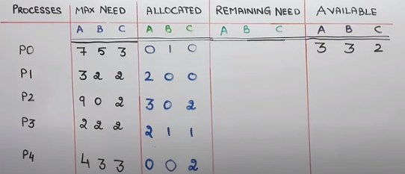
Q. Consider the following case where total number of instances of A, B and C are 10,5 and 7. Find the safe state sequence.

Slide 25
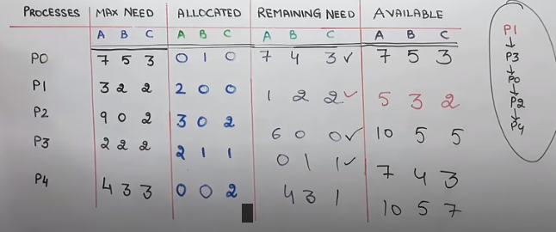

Slide 26
Recovery from Deadlock

Slide 27
Definition
Deadlock Recovery: Strategies to resolve or recover from deadlock situations.
Deadlock recovery refers to the set of strategies implemented to address and resolve deadlock situations within a computer system.
Deadlocks can occur when multiple processes are unable to proceed due to circular dependencies on resources.
Recovery mechanisms aim to break the deadlock and restore system functionality.

Slide 28
Recovery Strategies
1. Process Termination
Description: Kill one or more processes involved in the deadlock.
Advantages:
Quick resolution.
Frees up resources.
Disadvantages:
Potential loss of work.
Selecting which process to terminate can be challenging.

Slide 29
Recovery Strategies
2. Resource Preemption
Description: Preempt resources from one or more processes to break the deadlock.
Advantages:
Resources are efficiently utilized.
Allows for more fine-grained control.
Disadvantages:
May require rolling back processes.
Introduces complexity in resource management.

Slide 30
Other Issues: Communication Deadlock, Live lock, Starvation

Slide 31
1. Communication Deadlock
1.1 Definition
Communication Deadlock: A situation where processes are unable to communicate, leading to system inefficiencies.
1.2 Characteristics
Blocked Communication: Processes waiting for messages that are never sent or received.
Impact on System: Slows down or halts inter-process communication.
1.3 Example
Message Queues: Processes waiting indefinitely for messages that are never delivered.

Slide 32
2. Live Lock
2.1 Definition
Live Lock: Processes continuously change their state in response to others, but no progress is made.
2.2 Characteristics
Continuous Interaction: Processes are actively responding to each other's actions.
No Forward Progress: System remains in a constant state of interaction without accomplishing tasks.
2.3 Example
Two Processes Yielding: Each yielding to the other, preventing both from making progress.

Slide 33
3. Starvation
3.1 Definition
Starvation: A situation where a process is unable to gain the resources it needs for an extended period.
3.2 Characteristics
Resource Deprivation: Process consistently denied access to essential resources.
No Progress: Process unable to complete its tasks.
3.3 Example
Resource Allocation: A low-priority process consistently denied access to critical resources.

Slide 34
4. Mitigation Strategies
4.1 Communication Deadlock
Proper Resource Management: Ensure timely release of communication resources.
Timeout Mechanisms: Implement timeouts for waiting processes.
4.2 Live Lock
Intelligent Decision Making: Implement mechanisms for processes to make informed decisions.
Randomized Backoff: Introduce randomness in decision-making to break the cycle.
4.3 Starvation
Priority Adjustment: Adjust process priorities to ensure fair resource allocation.
Resource Release Policies: Implement policies to release resources periodically.

